Slide 1
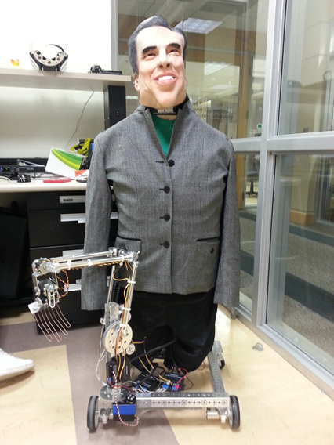
Nixon Bohr
Created by: Jordan fluth and Vernon jones

Slide 2
Inspiration
The idea for this project came after seeing a youtube video of a masters thesis project involving a Kinect and LEGO NXT brick.
http://www.youtube.com/watch?v=FTBBlt9uk1A

Slide 3
hardware required
A laptop with Bluetooth connection
A Microsoft Xbox Kinect
LEGO NXT Brick
Two TETRIX motor controllers
A TETRIX servo controller
12V battery

Slide 4
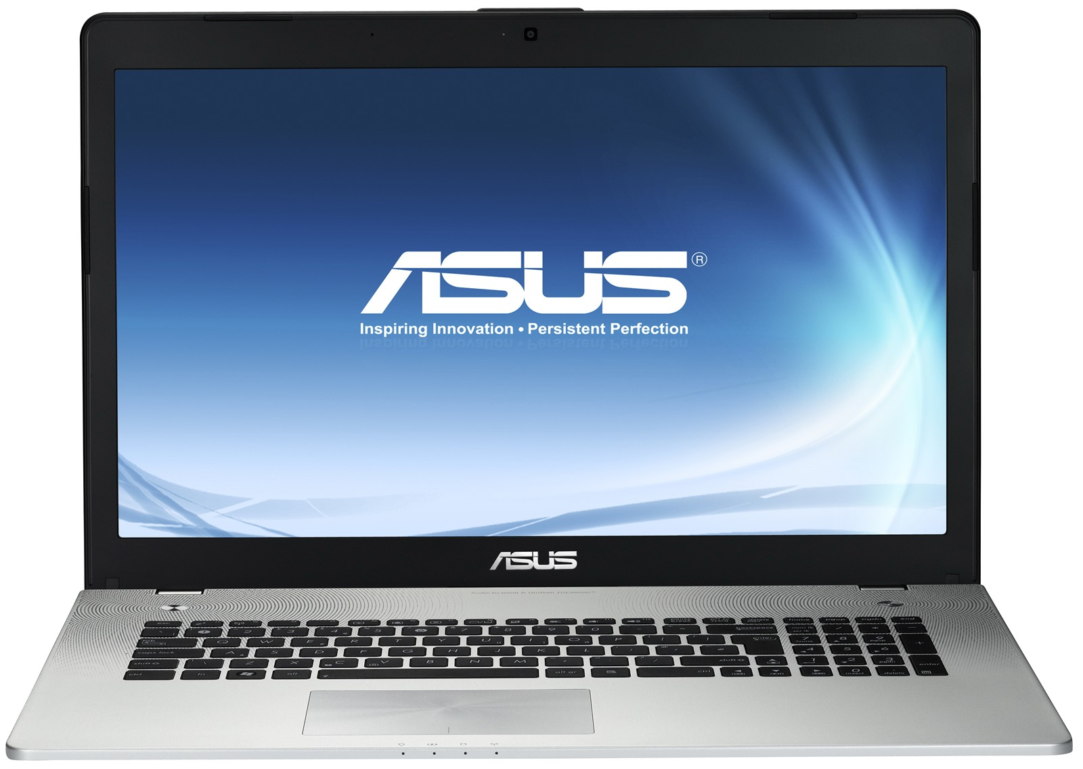
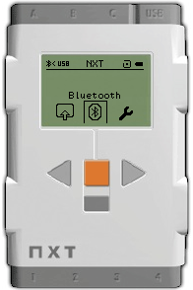
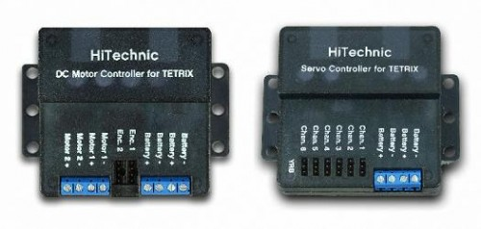

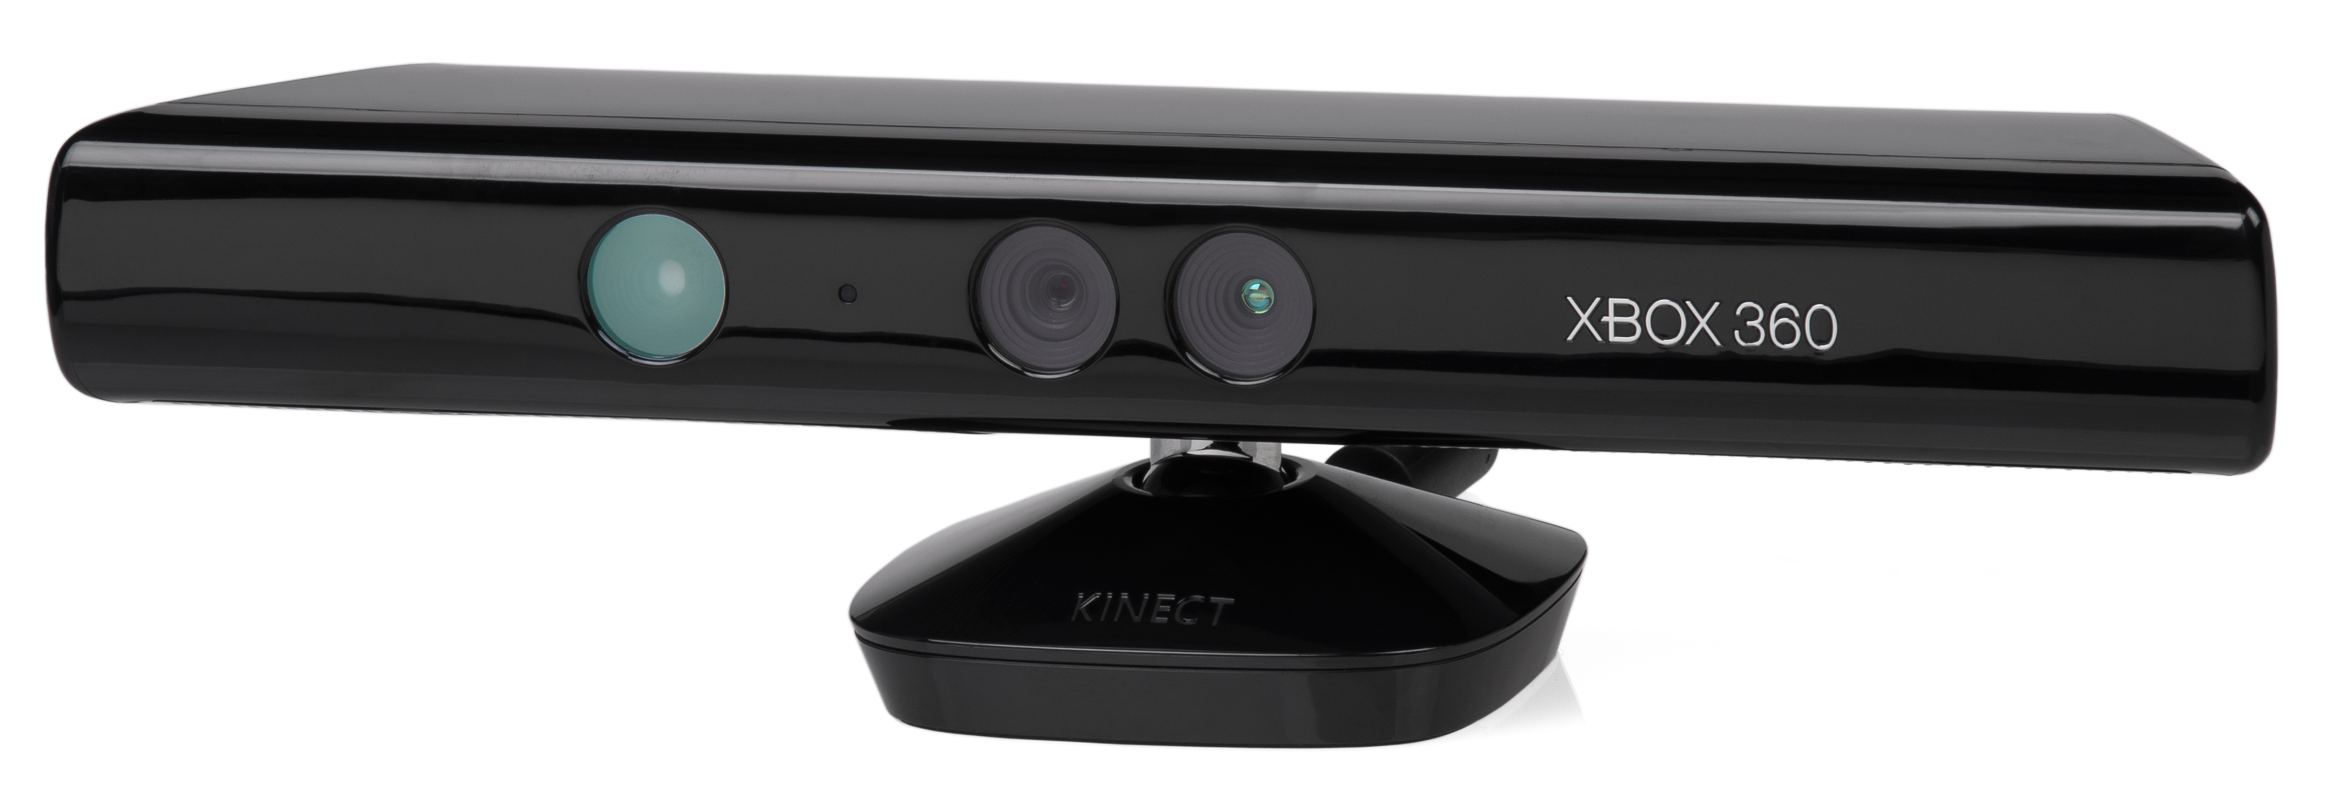
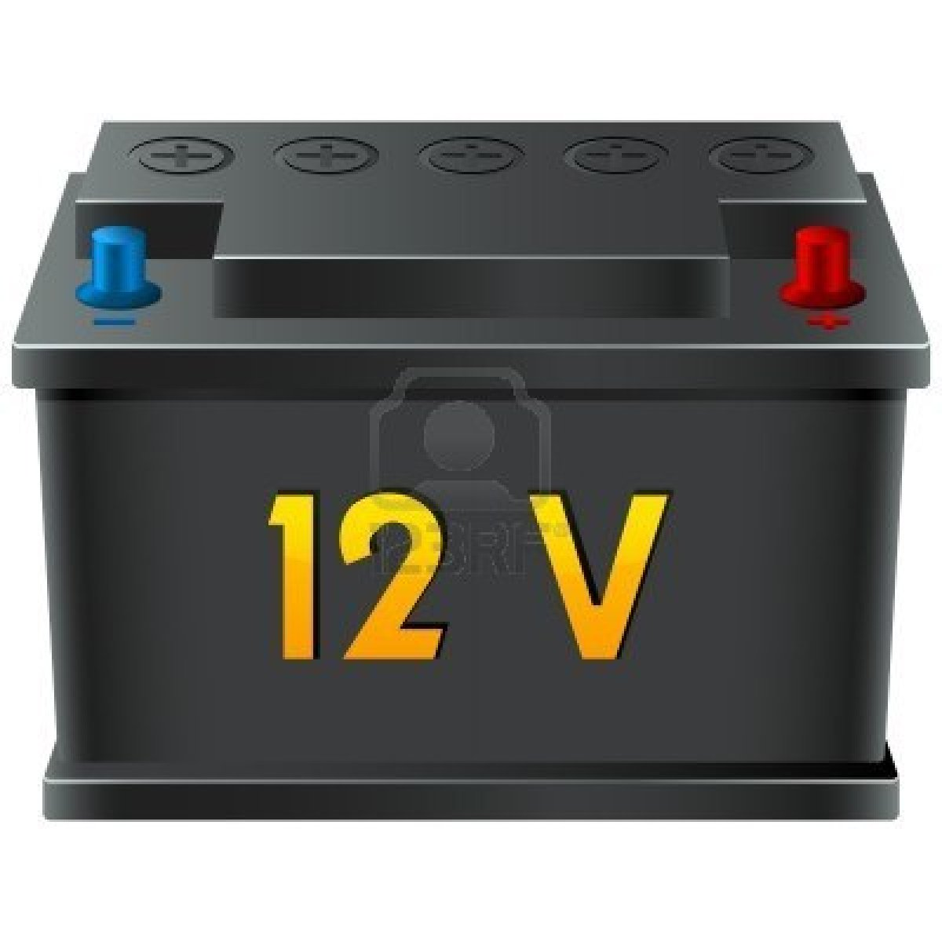
Hardware Setup

Slide 5
Software required
ROBOTC IDE
FAAST
Kinect development software

Slide 6
Initial condition of robot
The initial condition was not great. It was a head and shoulders mounted on a motorized platform. All of our motor controllers were missing along with the LEGO NXT brick and the face skin was beyond repair.

Slide 7
Objective
Create serial communication between the laptop and the LEGO NXT brick over Bluetooth
Program gestures to be recognized by the Kinect and translated into physical movements on the robot for driving operations
Program gestures to be recognized by the Kinect and translated into physical movements on the robot for controlling the arm
Refine motion controls such that we drive over to an object, pick it up and place it in a desired location

Slide 8
Visual Basic

Slide 9
Bluetooth mailbox

Slide 10
Robot control state diagram
w
s
MOVE HAND
MOVE ARM
MOVE WHEELS
w’
s’
s’

Slide 11
Move Wheel State diagram
f
b
FORWARD
BACKWARD
f
b
STOP
l
f
All inputs of (s) will move to this state
r
b
l
r
l
LEFT
RIGHT
r

Slide 12
ARM state diagram
SHOULDER DOWN
SHOULDER UP
IDLE
ELBOW DOWN
ELBOW UP

Slide 13
Hand state diagram
WRIST UP
HAND OPEN
WRIST LEFT
IDLE
HAND CLOSE
WRIST RIGHT
WRIST DOWN

Slide 14
results
Complete mobility control of robot
Complete control of arm with 6 degrees of freedom
Ability to switch between arm mode and drive mode

Slide 15
Technical problems
Original plan involved Kinect and laptop mounted on robot
Kinect requires 120VAC
Extension cords??? No thanks…
Too much weight for 12VDC motors
Continuous rotation servos
Bad left/right shoulder servo

Slide 16
Future plans
Add parameter box in robot theater for people to be able to control Nixon Bohr
Add vision
Move arm to shoulder and add another
Add emotion with IGA

Slide 17
The end

